Slide 1
SRGAN and EDSR
Quantitative & Qualitative Results

Slide 2
Image Quality Assessment(IQA)
Objective IQA metrics | Subjective IQA metrics
Peak Signal-to-Noise Ratio(PSNR) Based on maximum pixel value (denoted as L) and the mean squared error (MSE) Structural Similarity(SSIM) Based on independent comparisons in terms of luminance, contrast, and structures. | Mean Opinion Score (MOS) Humans rate the SR images

Slide 3
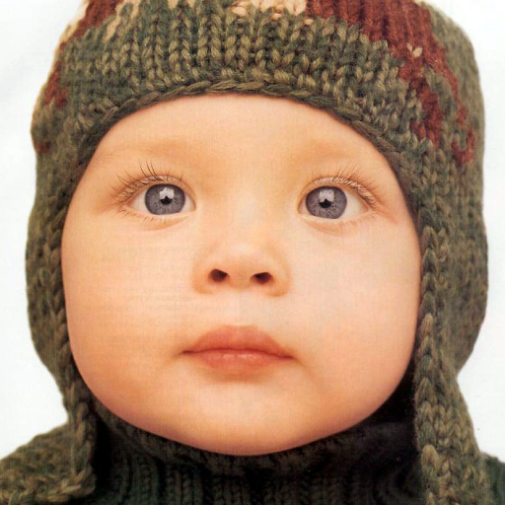
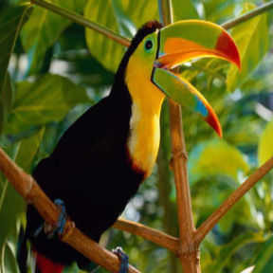
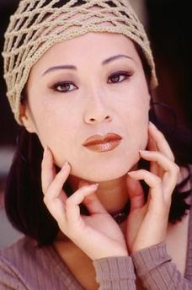
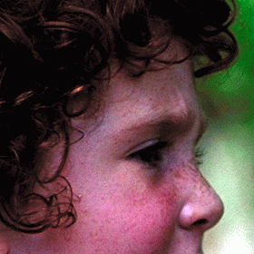
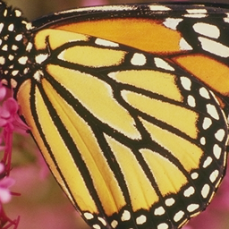
Set5 Dataset
baby.png
bird.png
woman.png
butterfly.png
head.png

Slide 4
Quantitative Results

Slide 5
SRGAN Quantitative Results (Set5 dataset)
PSNR and SSIM values for 2x scaling on individual images
Image Name | PSNR | SSIM
Butterfly.png | 29.54463153340315 | 0.9453742662512129
Baby.png | 33.32165620601004 | 0.9397032382401406
Head.png | 29.71782781509845 | 0.7690294623601887
Bird.png | 34.271153004221205 | 0.9407309651204455
woman.png | 31.510514843972203 | 0.9435342027099248

Slide 6
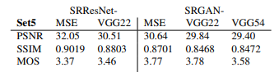
SRGAN
Our Results
Scaling Factor | PSNR | SSIM
2x | 31.673156680541013 | 0.9076744269363826
3x | 27.28131201581914 | 0.8056071179076006
4x | 27.115595000355636 | 0.8231551099827381
Results from paper

Slide 7
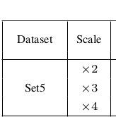
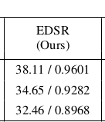
EDSR Quantitative Results (Set5 dataset)
Scaling Factor | PSNR | SSIM
2x | 37.985 | 0.961
3x | 34.367 | 0.927
4x | 32.095 | 0.892
Our Results
Official Results

Slide 8

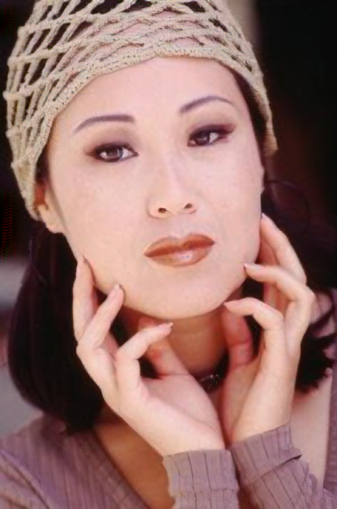

Qualitative Results
Low Resolution
Input Image
SRGAN
EDSR
High Resolution
Ground Truth

Slide 9
Zoomed Images (2x upscaling)
Low Resolution
Input Image
SRGAN
High Resolution
Ground Truth
EDSR

Slide 10

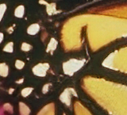

Zoomed Images (2x upscaling)
Low Resolution
Input Image
SRGAN
EDSR
High Resolution
Ground Truth

Slide 11

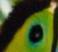

Zoomed Images (2x upscaling)
Low Resolution
Input Image
SRGAN
EDSR
High Resolution
Ground Truth

Slide 12
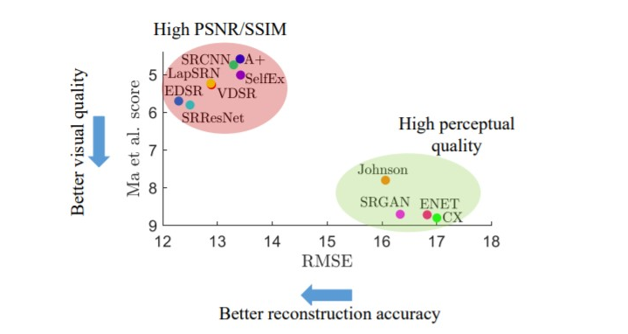
Conclusion: The perception-distortion tradeoff
Y. Blau and T. Michaeli, “The perception-distortion tradeoff,” in CVPR, 2018.
It was proven mathematically that distortion (e.g., PSNR, SSIM) and perceptual quality (e.g., MOS) are at odds with each other, and shown that as the distortion decreases, the perceptual quality must be worse.

